Slide 1
Introduction to Godot 4
Mack 2023

Slide 2
Learning Objectives
Students will be able to install the Godot game engine on their computers.
Students will become familiar with the Godot editor interface and its various features.
Students will be able to set up their first Godot project using the Godot Project Manager.

Slide 3
Godot
Godot is a rising game engine in the game development space. It is very versatile which has caused it to grow very rapidly in recent years. The engine will allow you to make 2D and 3D games to create whatever game you want. In this course, we will be teaching you from the ground up from having no knowledge of the engine to creating your first game.

Slide 4
Godot
Godot is free and open source and has been getting consistent updates over the years, which has made it very exciting and a perfect pick for getting started in game development. It is very user friendly, lightweight, and contains its own built-in code editor, which means you don’t have to download any additional programs to use the engine.

Slide 5
Why is the Godot Editor Important?
Godot is a lightweight game engine that is perfect for beginners. It is easy to install and use, and comes with all the latest features and bug fixes. In this lesson, we will look at how to install Godot and get started with your first project.

Slide 6
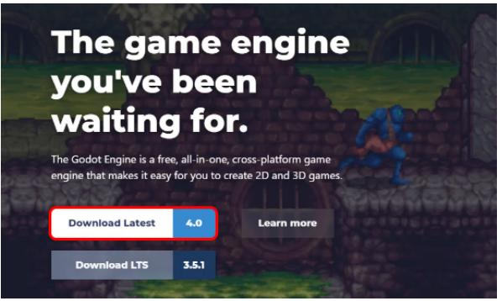
Downloading Godot
The first step is to download Godot. To do this, go to Godot’s website: https://www.godotengine.org and click on the Download Latest button.

Slide 7
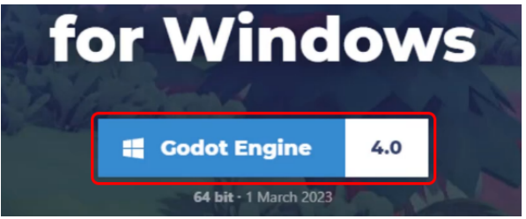
Downloading Godot
The website should automatically identify what platform you’re using (Windows, Mac, or Linux). Click on the blue Godot Engine button (not .net) to begin the download.

Slide 8
Downloading Godot
As Godot is a very lightweight engine, and the download size is only around 50 to 100 megabytes.
Once the download is complete, you can open the zip file and extract the main executable (This executable will be named something along the lines of: Godot_v4.0-stable_win64.exe).
It is recommended to store this somewhere like your desktop or documents, and you can create a shortcut to open it up.

Slide 9
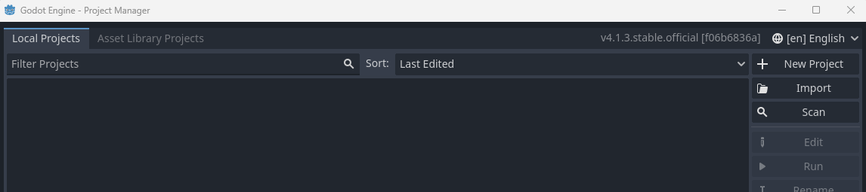
Opening the Project Manager
Once you have extracted the main executable, you can open it up by double-clicking on it.
This will open the Godot Project Manager. If you get a pop-up when you open it, just press Cancel. This is where you can create new projects, open existing projects, check versions, and remove projects.
You can also import projects, but this is not necessary for now.

Slide 10
Godot 4.0
As Godot is a very lightweight engine, and the download size is only around 50 to 100 megabytes.
Once the download is complete, you can open the zip file and extract the main executable (This executable will be named something along the lines of: Godot_v4.0-stable_win64.exe).
It is recommended to store this somewhere like your desktop or documents, and you can create a shortcut to open it up.

Slide 11
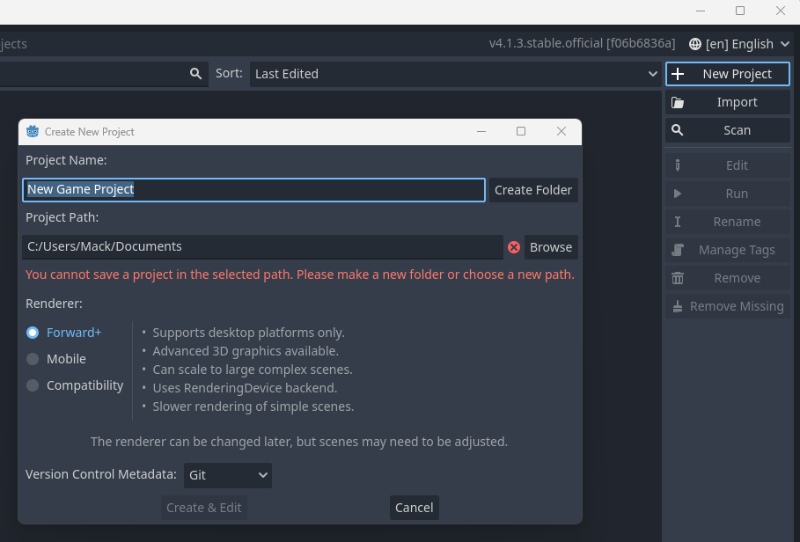
Creating a New Project
To create a new project, open the Godot Engine project manager and click on the New Project button in the top right corner.

Slide 12
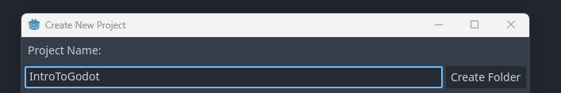
Creating a New Project
This will open a new window where you can set up a few things. First, give your project a name. For this example, we will call it Intro to Godot.

Slide 13
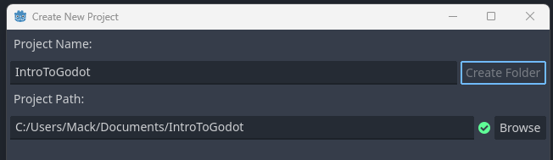
Creating a New Project
Next, choose a project path. This is where your project files will be stored. By default, it should be in your documents folder.
If you wish, you can create your own dedicated folder for Godot projects.
However, the project must have an empty folder to begin with, so either select this manually in your Project Path or press the Create Folder button, which will add a new folder automatically to your selected path.

Slide 14
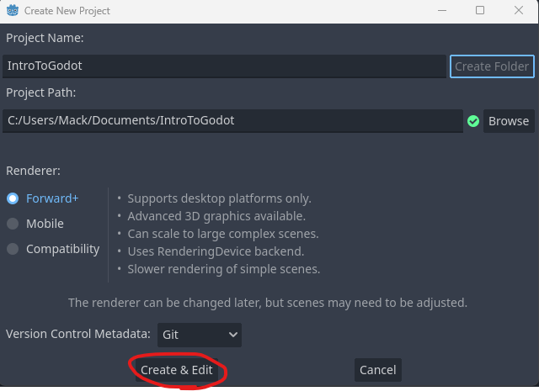
Creating a New Project
Once you have chosen a project path, press Create and Edit. This will close the project manager and automatically open the new project in the Godot Engine.

Slide 15
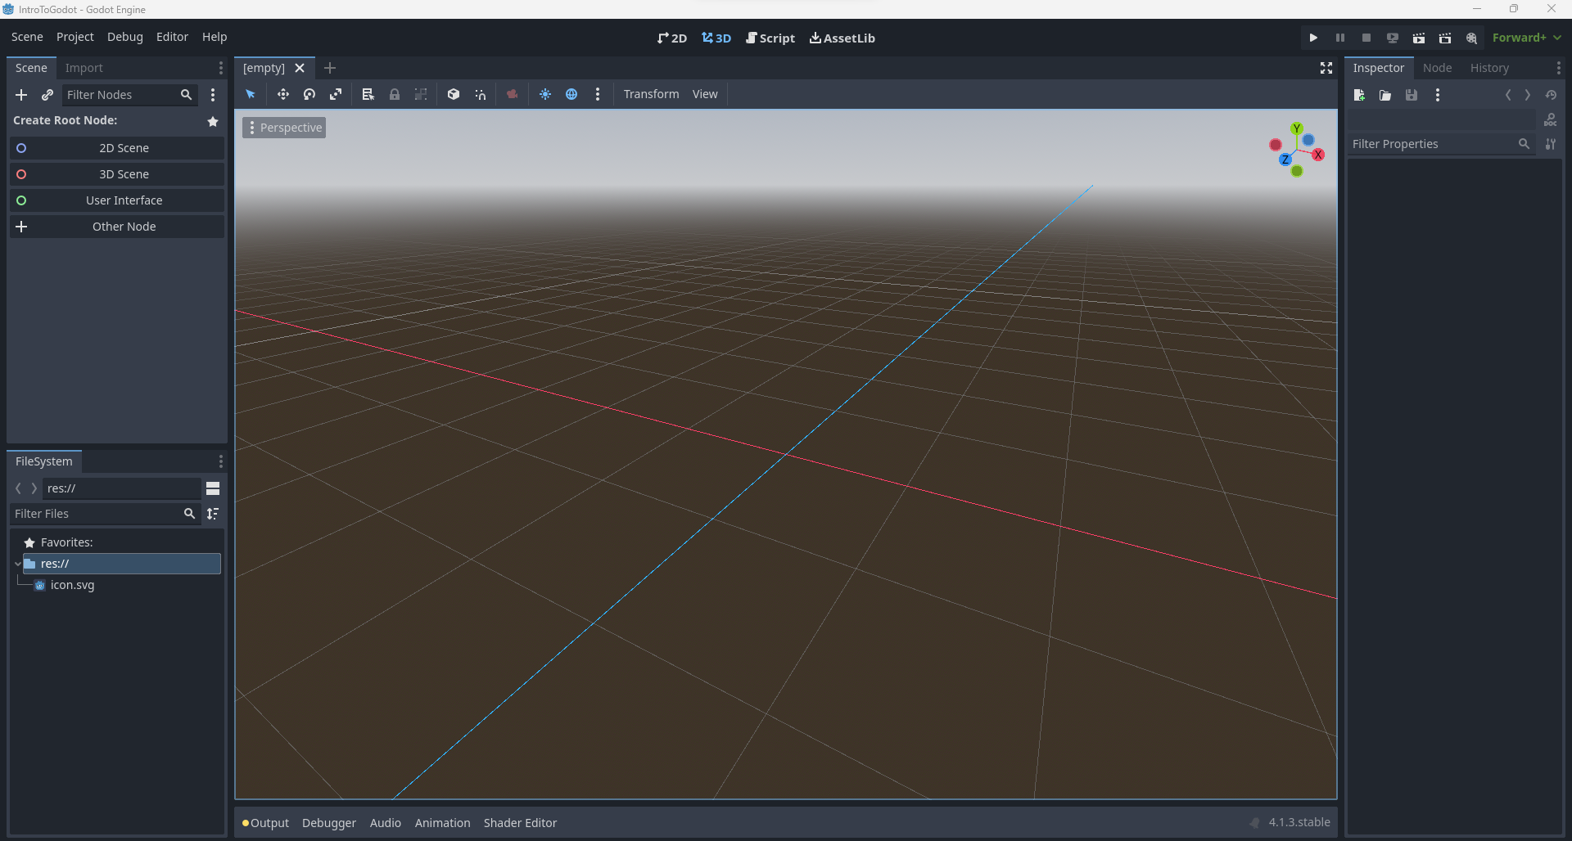
Creating a New Project
Once you have chosen a project path, press Create and Edit. This will close the project manager and automatically open the new project in the Godot Engine.

Slide 16
Editor Overview

Slide 17
Creating a New Project
To begin with, it is important to understand the basics of the Godot editor in order to make the most of the engine. We will explore the different windows and features of the Godot Editor, and how they can be used to create a game.
To begin with, you will notice the engine is split up into multiple windows, which we will take a look through individually. If you want to resize any of the windows, you can click and drag the sections between the tabs.

Slide 18
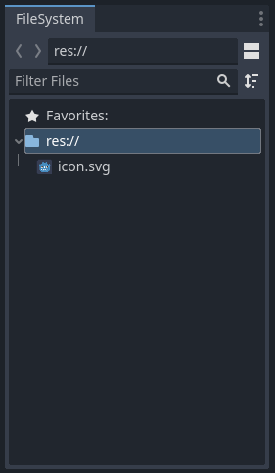
File System
In the bottom left, you will find the File System, which is like a file explorer on your computer. It allows you to store all of the different folders and files that make up your project. When you start writing code or importing 3D models, textures, and audio files, they will be stored in the File System. The File System will allow us to create sub-folders to organize our project and assets.
By default, there is one file in the project called icon.svg. This is the default icon for the game which you may replace at a later time. We will use the File System a lot once we start creating files and scenes.

Slide 19
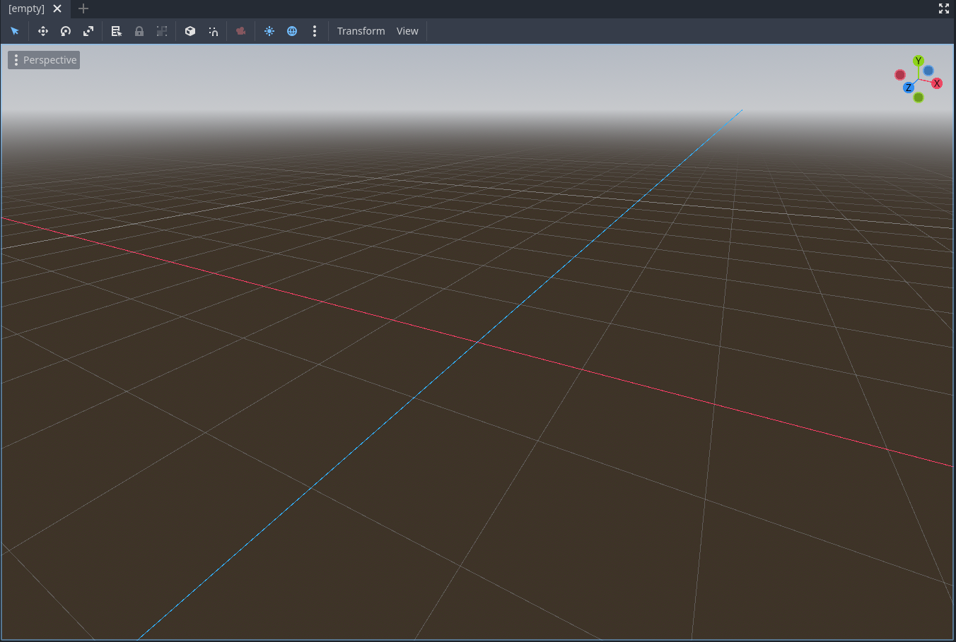
Viewport Window
In the center of the editor is a large window, which is basically a view into our game world. It is interactive and allows us to move our nodes around the scene to put together and edit our level. It is used in most parts of the game, so you will quickly get a good understanding of how this window works when we start creating our game.

Slide 20

Viewport Window
Currently, it has a 3D view. As Godot is a 3D and a 2D engine, you can switch between these views at the top depending on what project you are working on. Here, you can also switch to the Script for editing code.

Slide 21
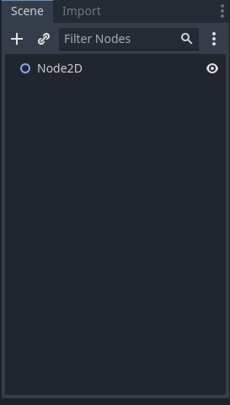
Scene Window
The Scene window is a list of all the nodes that make up your current scene. Everything in your game is made up of nodes branching from the top node (also known as the root node). You can create a 2D scene, a 3D scene, a user interface, or other as your root node.
As we will be using a Node2D node as the root, we will select the 2D Scene option.

Slide 22
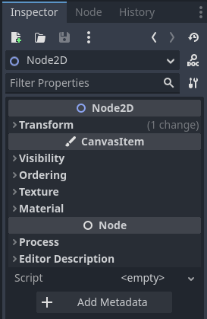
Inspector Window
When you select a node in the Scene window you can see its information in the Inspector window, on the right-hand side of the screen. The inspector is where you can view and modify the properties of the selected node, for example, if you had the Player node selected, you could change its information such as the Player’s position.

Slide 23

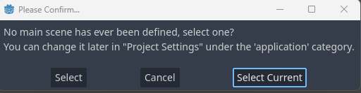
Play Button
The Play button is positioned above the Inspector window and allows you to launch your game. You can continue the setup by pressing the button.
When you click on it, it will ask you to confirm your default scene, so we will select the Select Current option.

Slide 24
Play Button
You can then save your scene, we will name ours TestScene.tscn and it will launch up a game window. To get out of the game window, you can click on the x or the stop button at the top right corner of the editor.
You will also notice, in the File System a new file has been created representing the scene you just saved.

Slide 25
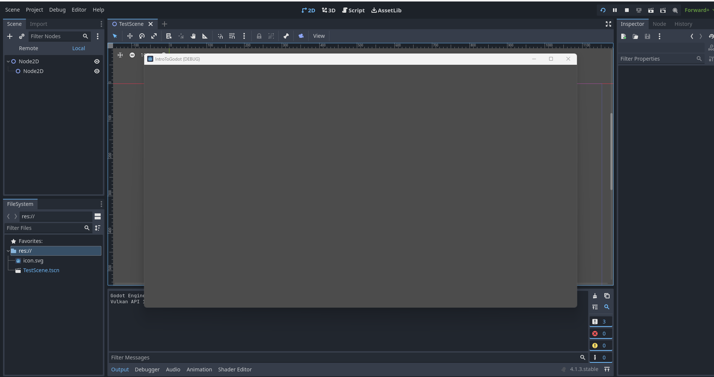
Play Button
You can then save your scene, we will name ours TestScene.tscn and it will launch up a game window. To get out of the game window, you can click on the x or the stop button at the top right corner of the editor.
You will also notice, in the File System a new file has been created representing the scene you just saved.

Slide 26
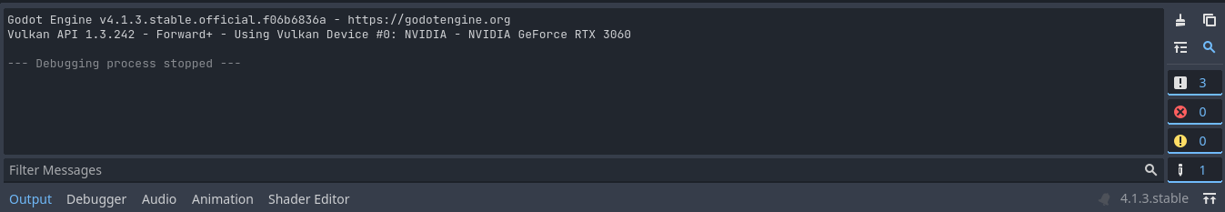
Output
When you run the game it will open the Output window, which is where error messages or warnings will be displayed. If there is a problem in your game, the output window will open up and display the problem in red.

Slide 27
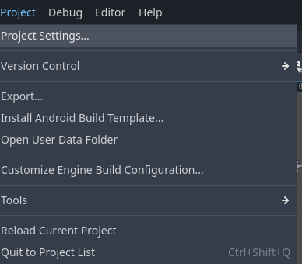
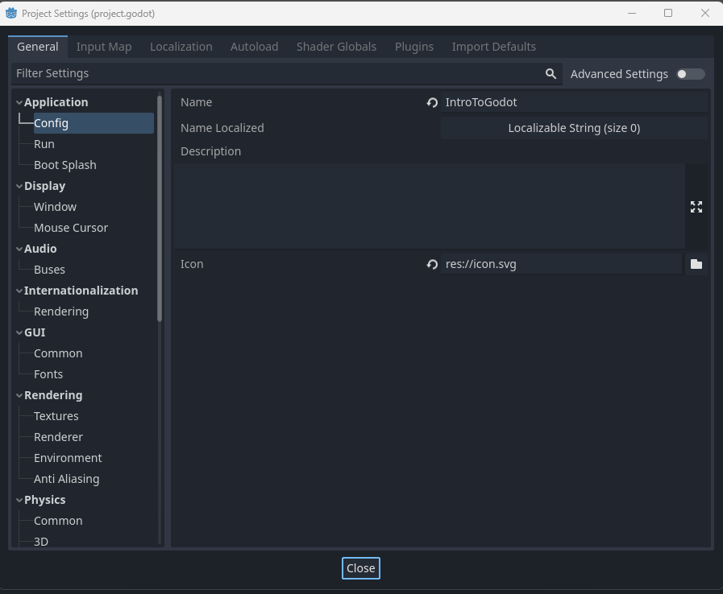
Project Settings
The Project Settings window can be accessed from the Project tab on the top menu row. There are also many other interesting options along this menu.

Slide 28
Project Settings
The Project Settings window allows you to manage the background settings for your project, such as the name, window size, and rendering and text settings. This is an important window, but we will not be focusing on it just yet.
By understanding the basics of the Godot Editor, you can make the most of the engine and create amazing 3D and 2D games. In the next lesson, we will look at understanding what nodes and scenes are, and how they interact with each other.

Slide 29
Scene Navigation
In the center of the Godot Editor, you will notice one large window, this is the scene viewport that allows us to see and edit the scene from the editor.

Slide 30

2D Mode
With the 2D mode selected, you can use the mouse to navigate the scene.
In 2D mode, you can use the middle mouse button to pan around the screen. To zoom in and out, use the scroll wheel.

Slide 31

3D Mode
With the 3D mode selected, the controls to navigate the scene change slightly.
In 3D mode, you can use the middle mouse button to rotate around the center. Additionally, with the right mouse button held, you can then use the WASD keys to fly around. To go up, press E, and to go down, press Q.

Slide 32

Importing Assets
An asset is a file that can be used in a game. This can include textures, 3D models, audio clips, sound effects, scripts, and any other type of file that can be stored on a computer and make use of in our game.

Slide 33
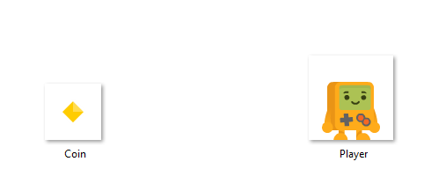
Using Sprites
We will be using sprites, which are 2D textures used for 2D games. In the Google Classroom assignment, you can find a set of assets that we can use for our first example game.
Once the file is downloaded, you can extract the content and inside there will be a folder called Sprites which contains the .png files needed for this course.

Slide 34
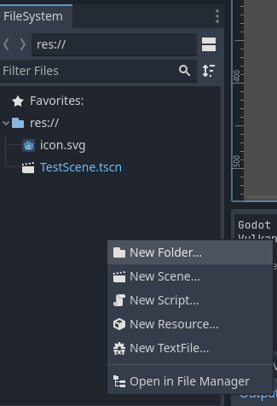
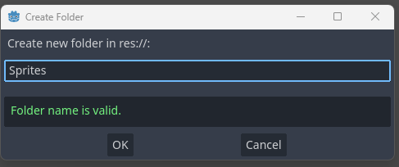
Using Sprites
Before importing the assets into the Godot Editor, we first need to create a New Folder in the FileSystem, by right-clicking in a blank space.
You can then name this Sprites.

Slide 35
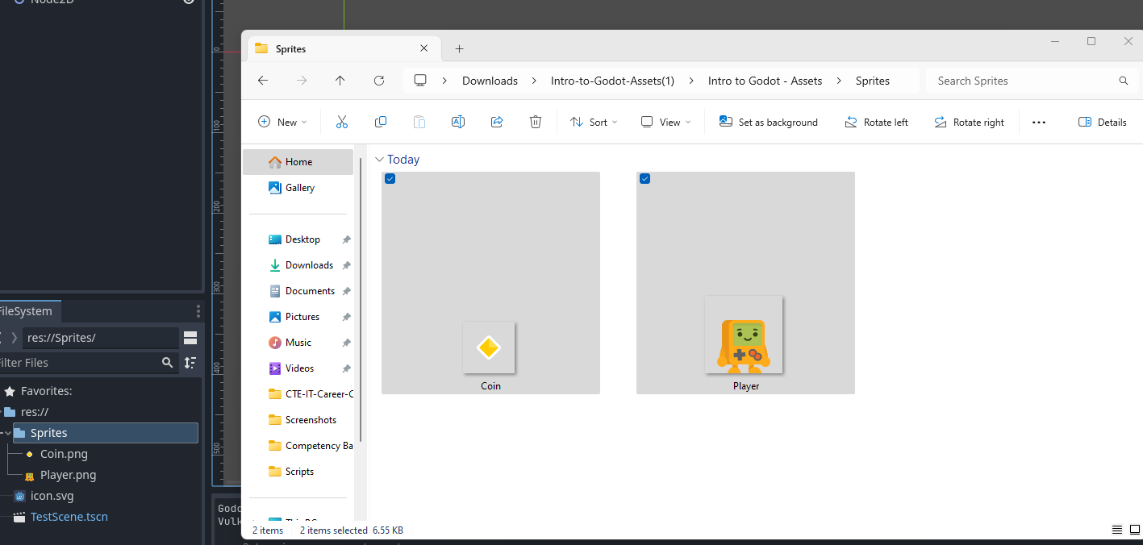
Importing Assets
To import the assets, open the Sprites folder which contains the .png files. Then, drag them into the Sprites folder we just created in the file system.
This process works the same for other assets such as audio files, 3D models, and textures.

